Slide 1
Lab(2) Recursive Descent Parser
Compiling Techniques
Zhou, Erqiang

Slide 2
Recursive Descent Parsing
exp: factor
| exp '+' factor
| exp '-' factor
;
factor: term
| factor '*' term
| factor '/' term
;
term: NUMBER
| '-' term
;
School of Information and Software Engineering
Zhou, Erqiang

Slide 3
Recursive Descent Parsing
exp: factor
| exp '+' factor
| exp '-' factor
;
language：
factor +/- factor +/- factor ...
program：
void exp(){
factor();
while( tok == '+' || tok == '-'){
advance();
factor();
}
}
+/- factor +/- factor ...
repeated part
School of Information and Software Engineering
Zhou, Erqiang

Slide 4
Recursive Descent Parsing
factor: term
| factor '*' term
| factor '/' term
;
language：
term */ term */ term ...
program：
void factor(){
term();
while( tok == '*' || tok == '/'){
advance();
term();
}
}
*/ term */ term ...
repeated part
School of Information and Software Engineering
Zhou, Erqiang

Slide 5
Recursive Descent Parsing
language：NUMBER、 - NUMBER
- - NUMBER、- - - NUMBER
program：
void term(){
if( tok == NUMBER );
advance();
else if ( tok == '-'){
advance();
term();
}
else error();
}
term: NUMBER
| '-' term
;
School of Information and Software Engineering
Zhou, Erqiang

Slide 6
Recursive Descent Parsing
Pure syntax analysis only check
whether token sequence is valid or not
such as: to check whether -5+20*5-3 is valid or not
Real compiler
need to restore the structure of token sequence
Syntax Tree
School of Information and Software Engineering
Zhou, Erqiang

Slide 7
Recursive Descent Parsing
exp: factor
| exp '+' factor
| exp '-' factor
;
factor: term
| factor '*' term
| factor '/' term
;
term: NUMBER
| '-' term
;
exp
exp
exp
factor
factor
factor
term
factor
term
term
term
term
-
5
+
20
*
5
-
3
School of Information and Software Engineering
Zhou, Erqiang

Slide 8
Recursive Descent Parsing
Abstract Syntax Tree, AST
(抽象的语法树)
exp
exp
-
exp
+
3
factor
factor
factor
term
factor
-
*
term
term
term
term
null
5
20
5
-
5
+
20
*
5
-
3
School of Information and Software Engineering
Zhou, Erqiang

Slide 9
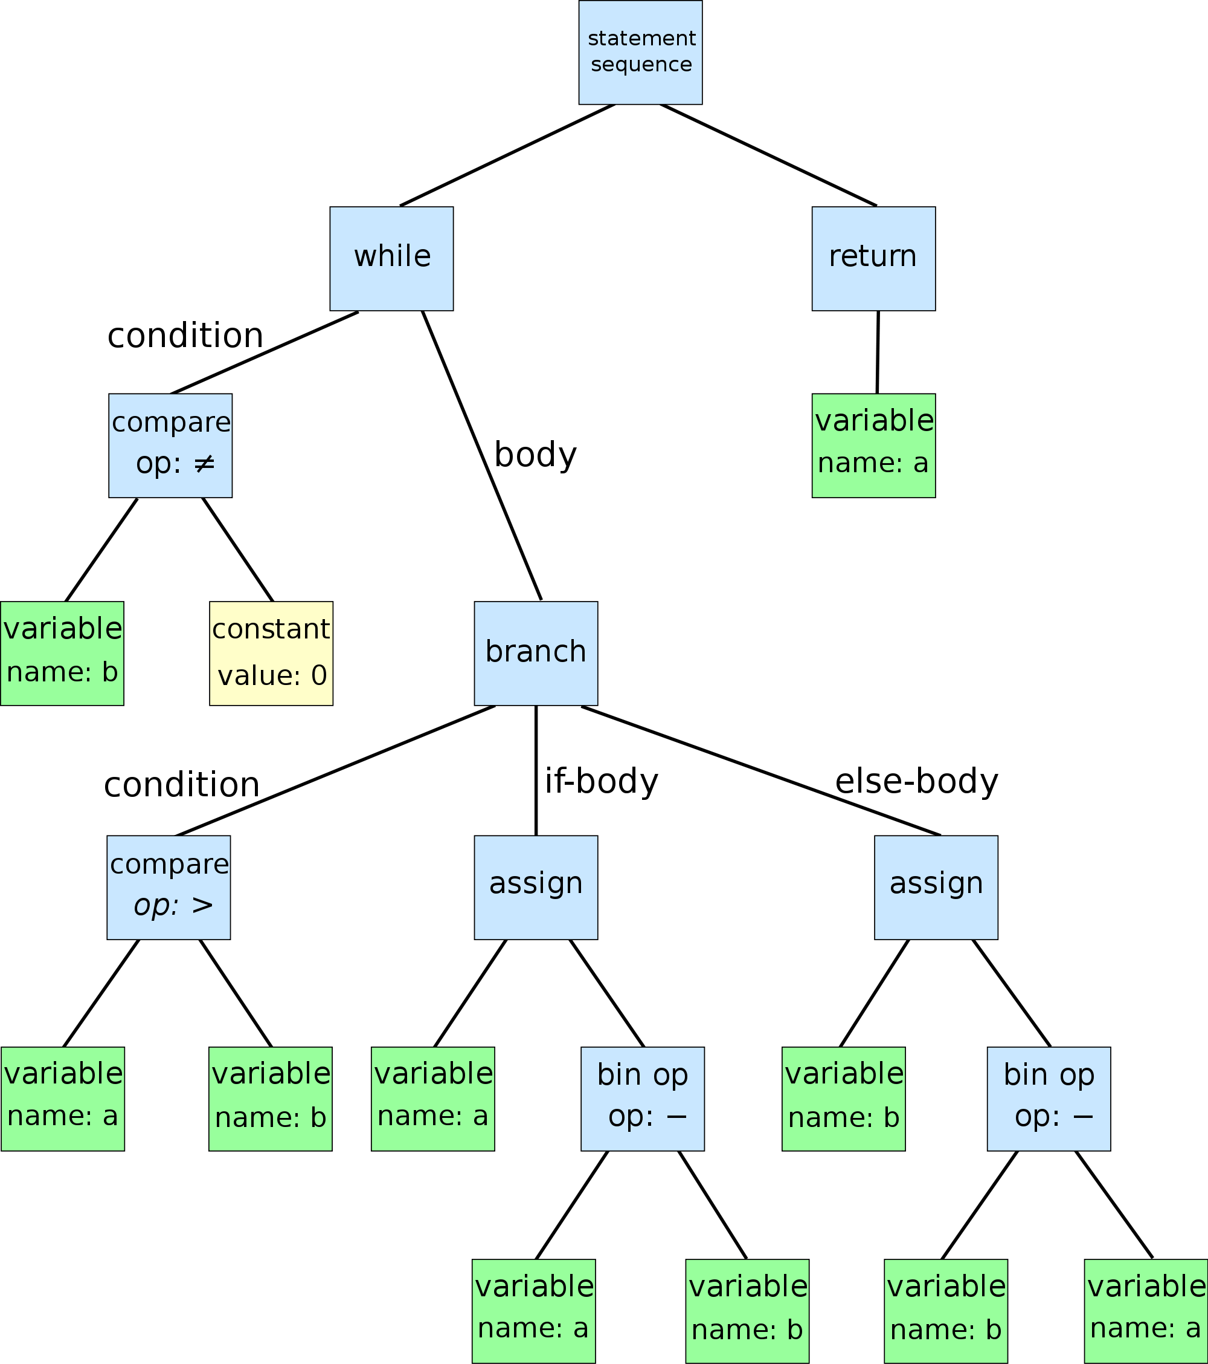
Abstract Syntax Tree
while b ≠ 0
if a > b
a := a − b
else
b := b − a
return a
School of Information and Software Engineering
Zhou, Erqiang

Slide 10
Abstract Syntax Tree
AST Design
all node using one struct type
How to distinguish different type of node?
Assignment or Selection?
A Flag is needed.
Max number of branch for each node
expression at most has two operands
Need to save the operator
School of Information and Software Engineering
Zhou, Erqiang

Slide 11
Abstract Syntax Tree
AST Design
typedef struct _ast ast;
typedef struct _ast *past;
struct _ast{
int ivalue;
char* nodeType;
past left;
past right;
};
School of Information and Software Engineering
Zhou, Erqiang

Slide 12
Abstract Syntax Tree
past astFactor()
{
past l = astTerm();
while(tok == '*' || tok == '/')
{
int oper = tok;
advance();
past r = astTerm();
l = newExpr(oper, l, r);
}
return l;
}
Recursive Descent Functions
void factor(){
term();
while( tok == '*' || tok == '/')
{
advance();
term();
}
}
School of Information and Software Engineering
Zhou, Erqiang

Slide 13
Lab Tasks
1. To learn the provided method for "expression gram"
understand rdlex.l、rdparser.c
create a project in Eclipse and debug it
2. To learn the grammar in rdgram.txt
compare it with the grammar provided in lab 1
School of Information and Software Engineering
Zhou, Erqiang

Slide 14
Lab Tasks
3. Write a recursive descent parser according to grammar given in rdgram
(1)a parser does NOT generate an AST: rdcheck.c
(2)improve rdcheck.c so as to generate an AST: rdparser.c
(3)improve the lexer, showAst, main, etc. so that the parser (rdparser.c) can read a source file (such as test.c) from command line, after analysing this file, print its structure by calling function showAst.
School of Information and Software Engineering
Zhou, Erqiang

Slide 15
Requirement
1. All the work is done independently by youself only.
NO COPY
2. All files should be saved with utf-8.
School of Information and Software Engineering
Zhou, Erqiang

Slide 16
Requirement
3. Required Files：
Lexer file: rdlex.l
parser which does not generates AST rdcheck.c
parser which generates an AST rdparser.c
Report: recursive descent parser.docx
School of Information and Software Engineering
Zhou, Erqiang

Slide 17
Requirement
4. Submit Procudure
open http://www.weiyun.com/ and login with you qq account
make a directory with the form of“学号_姓氏_实验2”,
such as 2013110101011_zhou_lab2
upload all require files into this folder
share the folder without password
send the share link to eqzhou@163.com
School of Information and Software Engineering
Zhou, Erqiang

Slide 18
Requirement
5. Due time
2019-11-23 23:59:59
School of Information and Software Engineering
Zhou, Erqiang

Slide 19
THE END
QUESTIONS
School of Information and Software Engineering
Zhou, Erqiang

Slide 20
Recursive Descent Parsing
program
: external_declaration
| program external_declaration
;
external_declaration
: type declarator decl_or_stmt
;
decl_or_stmt
: '{' statement_list '}'
| '{' '}'
| ',' declarator_list ';'
| ';'
;
declarator_list
: declarator
| declarator_list ',' declarator
;
intstr_list
: NUMBER | STRING
| intstr_list ',' NUMBER
| intstr_list ',' STRING
;
declarator
: ID
| ID '=' expr
| ID '(' parameter_list ')'
| ID '(' ')'
| ID '[' expr ']'
| ID '[' ']'
| ID '[' expr ']' '=' '{' intstr_list '}'
| ID '[' ']' '=' '{' intstr_list '}'
;
parameter_list
: parameter
| parameter_list ',' parameter
;
School of Information and Software Engineering
Zhou, Erqiang

Slide 21
Recursive Descent Parsing
statement
: type declarator_list ';'
| '{' statement_list '}'
| expr_statement
| IF '(' expr ')' statement
| IF '(' expr ')' statement ELSE statement
| WHILE '(' expr ')' statement
| RETURN ';'
| RETURN expr ';'
| PRINT ';'
| PRINT expr_list ';'
| SCAN id_list ';'
;
statement_list
: statement
| statement_list statement
;
parameter
: type ID
;
type
: INT | STR | VOID
;
expr_statement
: ';'
| expr ';'
;
expr_list
: expr
| expr_list ',' expr
;
id_list
: ID
| id_list ',' ID
;
School of Information and Software Engineering
Zhou, Erqiang

Slide 22
Recursive Descent Parsing
mul_expr
: primary_expr
| mul_expr '*' primary_expr
| mul_expr '/' primary_expr
| mul_expr '%' primary_expr
| '-' primary_expr
;
primary_expr
: ID '(' expr_list ')'
| ID '(' ')'
| '(' expr ')'
| ID
| NUMBER
| STRING
| ID ASSIGN expr
| ID '=' expr
| ID '[' expr ']'
| ID '[' expr ']' '=' expr
;
expr
: cmp_expr
;
cmp_expr
: add_expr
| cmp_expr CMP add_expr
;
add_expr
: mul_expr
| add_expr '+' mul_expr
| add_expr '-' mul_expr
;
School of Information and Software Engineering
Zhou, Erqiang

Slide 23
Recursive Descent Parsing
What is the output after lexcial analysis for this code fragment？
enum {INT = 258, STR, VOID, ID, NUMBER, STRING, PRINT, RETURN, ...}
INT ID [ NUMBER ] = { NUMBER , NUMBER , NUMBER , NUMBER }
10 10 9 8 7
INT, ID, NUMBER are variables of an enumerable type
'[' ']' '{' ',' '=' represents the value of the character's ASCII code
STR ID ( INT ID ) { STR ID = STRING + STRING ; STR ID = STRING + ...
int array2[10] = {10,9,8,7};
str f(int a)
{
str b = "aaa" + "ddd";
str c = "ccc" + "bb";
print c;
return c;
}
School of Information and Software Engineering
Zhou, Erqiang

Slide 24
Recursive Descent Parsing
int array2[10] = {10,9,8,7};
str f(int a)
{
str b = "aaa" + "ddd";
str c = "ccc" + "bb";
print c;
return c;
}
program ==>
external_declaration
==> type declarator decl_or_stmt
==> INT ID '[' expr ']' = '{' intstr_list '}'
;
decl_or_stmt
: '{' statement_list '}'
| '{' '}'
| ',' declarator_list ';'
| ';'
;
declarator
: ID
| ID '=' expr
| ID '(' parameter_list ')'
| ID '(' ')'
| ID '[' expr ']'
| ID '[' ']'
| ID '[' expr ']' '=' '{' intstr_list '}'
| ID '[' ']' '=' '{' intstr_list '}'
;
School of Information and Software Engineering
Zhou, Erqiang

Slide 25
Recursive Descent Parsing
int array2[10] = {10,9,8,7};
str f(int a)
{
str b = "aaa" + "ddd";
str c = "ccc" + "bb";
print c;
return c;
}
program ==>
external_declaration
==> type declarator decl_or_stmt
==> INT ID [ expr ] = { intstr_list } ;
expr ==> cmp_expr ==> add_expr ==> mul_expr ==> primary_expr ==> NUMBER
intstr_list ==> intstr_list , NUMBER
intstr_list ==> intstr_list , NUMBER , NUMBER
intstr_list ==> intstr_list , NUMBER , NUMBER , NUMBER
intstr_list ==> NUMBER , NUMBER , NUMBER , NUMBER
==> INT ID [ NUMBER ] = { NUMBER , NUMBER , NUMBER , NUMBER }
token attributes 10 10 9 8 7
intstr_list
: NUMBER | STRING
| intstr_list ',' NUMBER
| intstr_list ',' STRING
;
School of Information and Software Engineering
Zhou, Erqiang

Slide 26
Recursive Descent Parsing
external_declaration
: type declarator decl_or_stmt
;
past external_declaration()
{
past result = NULL;
past t = type();
past d = declarator();
past ds = decl_or_stmt();
result = newExtDecl(t, d, ds);
return result;
}
School of Information and Software Engineering
Zhou, Erqiang

Slide 27
Recursive Descent Parsing
program
: external_declaration
| program external_declaration
;
recursive functions？
parameter_list
: parameter
| parameter_list ',' parameter
;
past program()
{
advance();
past ext = external_declaration();
past list = newList(NULL, ext);
while( tok )
{
ext = external_declaration();
list = newList(list, ext);
}
return list;
}
past parameter_list()
{
past result = newList(NULL, parameter());
while(tok == ',')
{
advance();
result = newList(result, parameter());
}
return result;
}
School of Information and Software Engineering
Zhou, Erqiang

Slide 28
Recursive Descent Parsing
int array2[10] = {10,9,8,7};
str f(int a)
{
str b = "aaa" + "ddd";
str c = "ccc" + "bb";
print c;
return c;
}
program ==>
program external_declaration
==> external_declaration external_declaration
==> ... type declarator decl_or_stmt
==> ... STR ID ( parameter_list ) { statement_list }
declarator
: ID
| ID '=' expr
| ID '(' parameter_list ')'
| ID '(' ')'
| ID '[' expr ']'
| ID '[' ']'
...
;
decl_or_stmt
: '{' statement_list '}'
| '{' '}'
| ',' declarator_list ';'
| ';'
;
School of Information and Software Engineering
Zhou, Erqiang

Slide 29
Recursive Descent Parsing
statement
: type declarator_list ';'
| '{' statement_list '}'
| expr_statement
| IF '(' expr ')' statement
| IF '(' expr ')' statement ELSE statement
| WHILE '(' expr ')' statement
| RETURN ';'
| RETURN expr ';'
| PRINT ';'
| PRINT expr_list ';'
| SCAN id_list ';'
;
statement_list
: statement
| statement_list statement
;
newDecl(...)
newCompStmt(...)
newExprStmt(...)
newIfStmt(...)
newWhileStmt(...)
newReturnStmt(...)
newPrintStmt(...)
newScanStmt(...)
School of Information and Software Engineering
Zhou, Erqiang

